Slide 1
NDU Library
& Learning Center
Dr. Mohan Ramaswamy Dean | Dr. Trela Anderson Writing & Communications Faculty

Slide 2
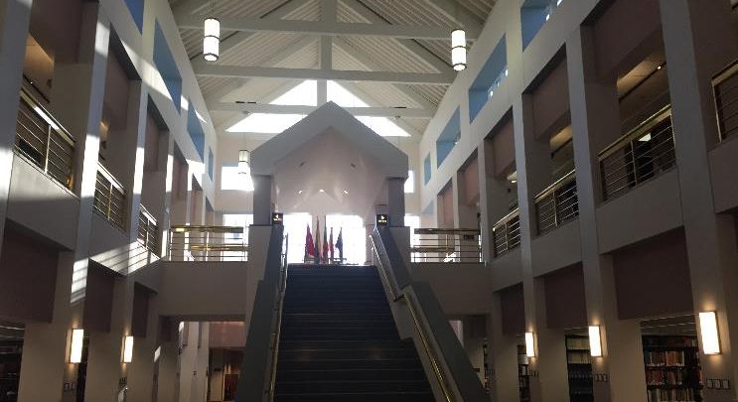
National Defense University Library
D.C. campus Library
Marshall Hall 2nd Floor

Slide 3
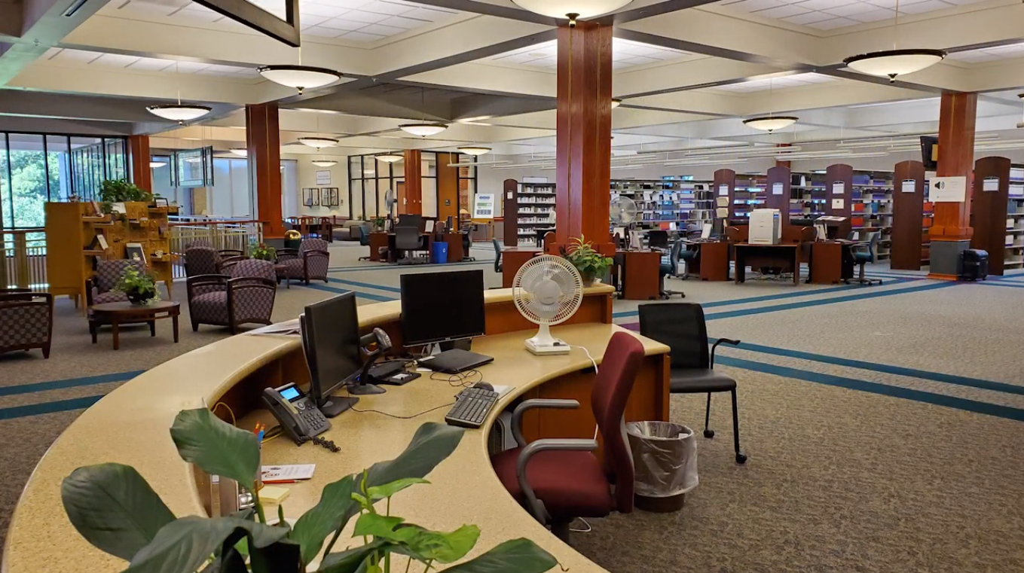
National Defense University Library
Norfolk campus Library
Okinawa Hall 2nd Floor

Slide 4
Things you’ll find in the Library
Research support from expert Librarians, Writing Instructors
Academic Wireless (campus-wide Wi-Fi)
Printers, scanners, NIPRNet (.mil) PCs
Quiet study spaces, Collaborative study spaces
Lunchtime workshops on library research and writing topics
Special Collections, Archives, Exhibits
Classified Documents Center (SCIF) w/ SIPRNet

Slide 5
Collections
Over 500,000 physical items—books, government documents, research reports, DVDs, audiobooks
100+ subscription databases covering an array of research topics
20,000+ electronic journals, newspapers, and market reports
150,000+ eBooks; many are downloadable
40,000+ unique digital archives (NDU student papers, CJCS papers, NDU Press, etc.)
Notes:
The Library collection, focused on the military arts and sciences, is one of the largest and richest in the world.

Slide 6
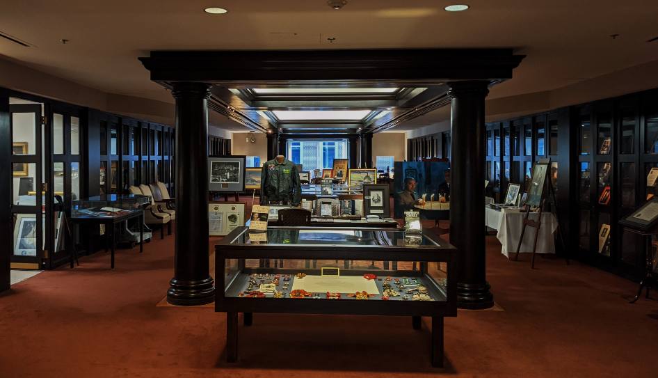
Special Collections & Archives
Archives of military leaders. Collections and papers from half of the retired Chairmen of Joint Chiefs of Staff
Collections from 6 of the retired Supreme Allied Commanders of Europe
Extensive unique collections from the recent wars in Iraq and Afghanistan
NDU student papers and thesis
Exhibits throughout the University are created by the Library staff
Grant Hall’s historic courtroom, site of the 1865 military tribunal of the Lincoln assassination conspirators
Notes:
The most recent exhibit by the library staff is the Powell Wing in Roosevelt Hall which was installed and dedicated to General Colin Powell last year.

Slide 7
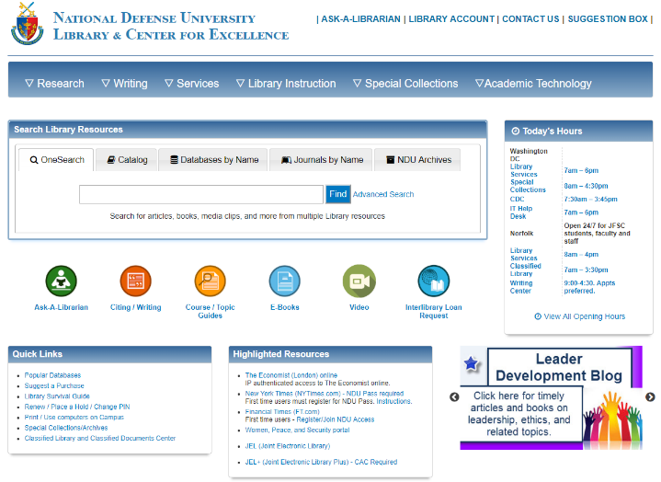
Online Library
Notes:
Even if some of you choose not to come to the library, I strongly encourage you to use the Virtual Library. This is your gateway into all the scholarly and authoritative sources your professors want you to use to support your papers.

Slide 8
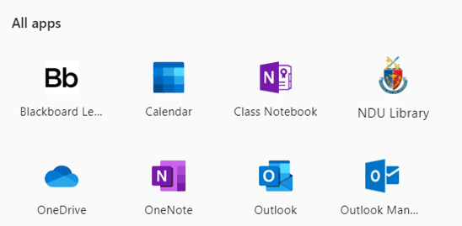
Online Library - Access
Step 1: Log into
Step 2: Choose "NDU Library"
Notes:
Even if some of you choose not to come to the library, I strongly encourage you to use the Virtual Library. This is your gateway into all the scholarly and authoritative sources your professors want you to use to support your papers.

Slide 9
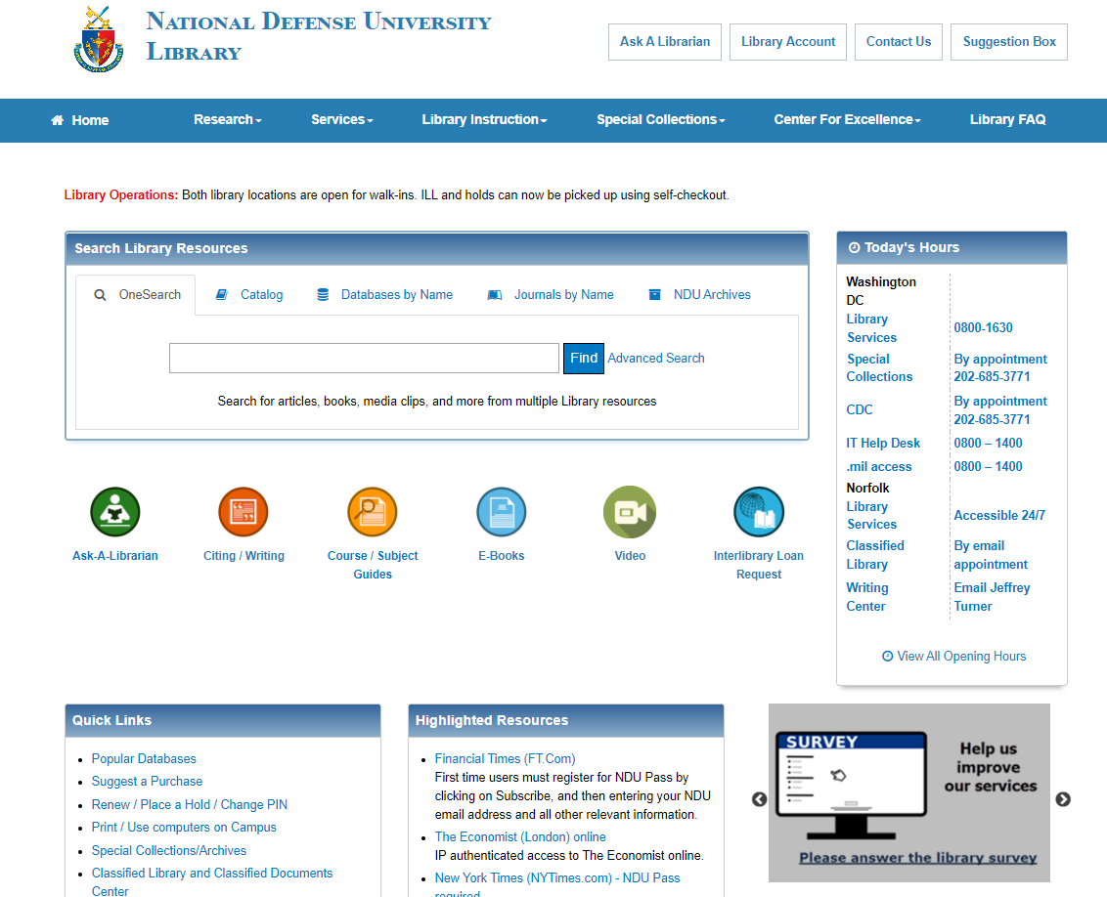
Online Library – 24/7
Notes:
Even if some of you choose not to come to the library, I strongly encourage you to use the Virtual Library. This is your gateway into all the scholarly and authoritative sources your professors want you to use to support your papers.

Slide 10
Online Library - Ask
Notes:
Even if some of you choose not to come to the library, I strongly encourage you to use the Virtual Library. This is your gateway into all the scholarly and authoritative sources your professors want you to use to support your papers.

Slide 11
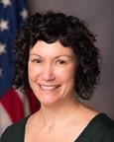
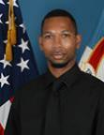
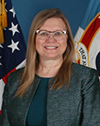
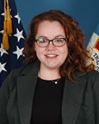
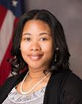
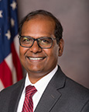
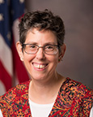
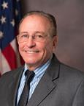
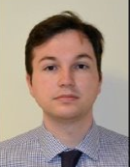
Research Librarian Team
Serves students located in DC, Norfolk, and Ft. Bragg

Slide 12
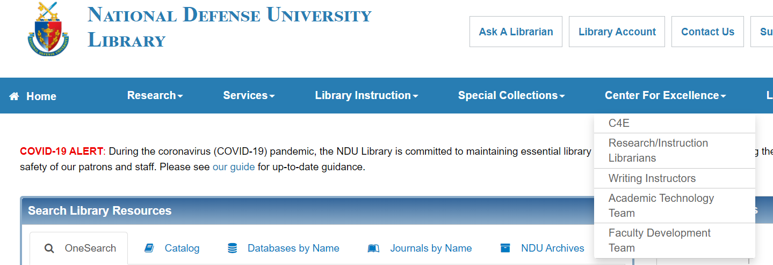
OnlineLibrary - Writing
Notes:
Even if some of you choose not to come to the library, I strongly encourage you to use the Virtual Library. This is your gateway into all the scholarly and authoritative sources your professors want you to use to support your papers.

Slide 13
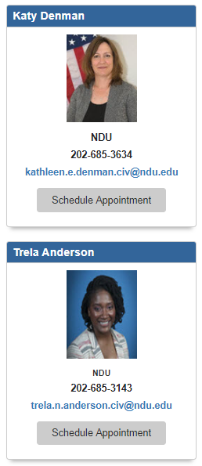
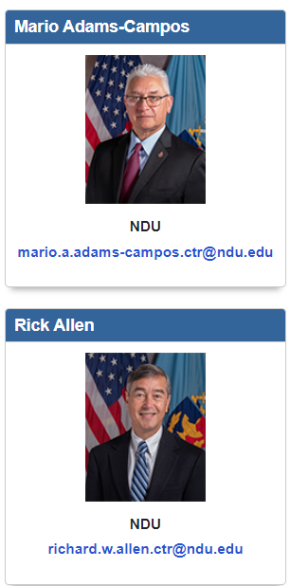
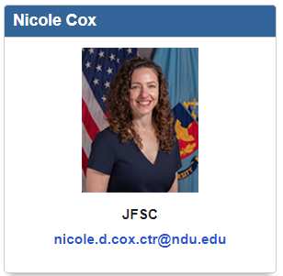
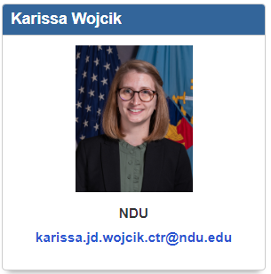
The Writing Center
Serves students located in DC, Norfolk, and Ft. Bragg

Slide 14
“Why Visit Your Campus Writing Center?”
“Writing isn’t easy,
and people need help.” (Ben Rafoth)
Writing Tutors Provide Writers With
Open conversation
Confidence and assurance
A sense of audience

Slide 15
Services
Providers
Library
Access to vetted information resources
Research assistance
Information literacy instruction
Research Librarians
Writing Center
Writing assistance
Platform & communication skills
Writing for publication
Writing Instructors
C4E-Writing-Instructors@ndu.edu
Information Technology
Service Desk assistance
IT Help Desk
help-ITD@ndu.edu

Slide 16
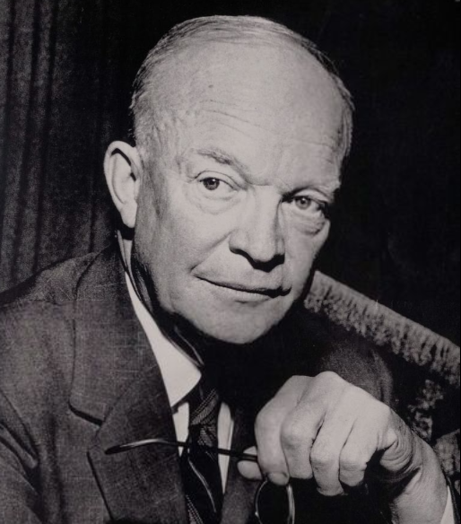
Information
is your competitive advantage
“…ever since the beginning of my administration I have issued directives to gather, in every feasible way, the information required to protect the United States and the free world against surprise attack and to enable them to make effective preparations for defense.”
General Dwight D. Eisenhower
President of the United States of America, 1953 –1961

